Slide 1
Chapter - 3
Security & Privacy of Data

Slide 2
Business Priorities
Data access security
Data Integrity / consistency
Data Privacy
Data Availability
Order changes according to business requirements

Slide 3
Threats to Information
Accidents & Disasters
  Fire, Flood, Eartquake, Terror, Plane crash, etc.
Employees & Consultants
  İntentionally
  Unintentionally
Business Partners
Outsiders, hackers, vandals
Viruses, worms, trojans
İll intentioned Competitors, technology spies

Slide 4
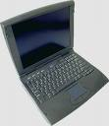
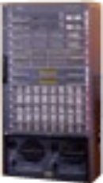
Internet Data Transmission
Next hops, ISPs
ISP
Remote Server
Destination
Local Server
Starting point

Slide 5

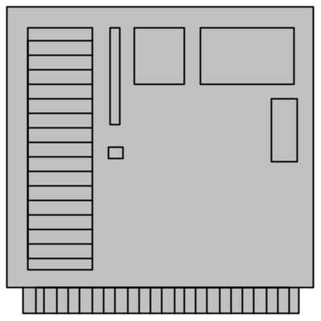



Security, Privacy, and Anonymity
Attacks
The Internet
Data
Normal user who creates data
interception
Monitoring

Slide 6

Virus
From: friend
To: victim
Message: Open the attachment for some excitement.
2
3
1
1. User opens an attached program that contains hidden virus
2. Virus copies itself into other programs on the computer
Virus spreads until a certain date, then it deletes files or harms data
Virus removal spends staff time
Virus attacks decrease productivity
Attachment
01 23 05 06 77 03
3A 7F 3C 5D 83 94
19 2C 2E A2 87 62
02 8E FA EA 12 79
54 29 3F 4F 73 9F
Virus code

Slide 7
Stopping a Virus
Backup your data
Never run applications unless you are certain they are safe.
Never open executable attachments sent over the Internet--regardless of who mailed them.
Antivirus software
  Needs constant updating
  Rarely catches recent viruses
  Can interfere with other programs
  May slow down performance
Ultimately, viruses sent over the Internet can be traced back to the original source.

Slide 8
Security Categories
Physical attack & disasters
  Backup-off-site
  Cold / Warm backup sites
  Hot site
  Disaster tests
  Do not forget or underestimate personal computers!
Logical
  Unauthorized disclosure of information
  Unauthorized modification
  Unauthorized withholding of service (denial of service)

Slide 9
Disaster Planning
Recovery Point Objective (RPO)
Recovery Time Objective (RTO)
Once the RPO for a given computer, system, or network has been defined, it determines the minimum frequency with which backups must be made. This, along with RTO, helps administrators choose optimal disaster recovery technologies and procedures.

Slide 10
Disaster Planning
BCP – Business Continuity Plan
There are some premier providers of computer backup facilities and disaster planning services.
Some firms provide a fleet of Mobile Data Centers that can be outfitted with a variety of distributed systems hardware and delivered at a disaster site within 48 hours.

Slide 11
Data Backup
Backup
  Data backups (directory, filesystem, database, etc)
  İmages (whole volume including OS)
  Offsite backup
Backup levels
  RAID (multiple drives)
  Real time replication
  Scheduled backups

Slide 12

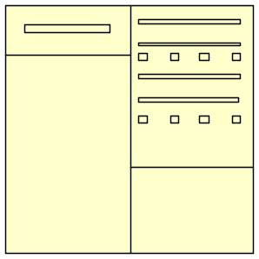


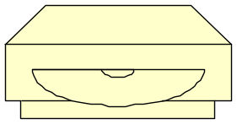
Data Backup
Power company
Backup PCs over network.
Use local duplicate mirrored servers for extreme reliability.
UPS
Offsite backups are critical.
Frequent backups enable you to recover from disasters and mistakes.

Slide 13
Some Common Attack Types
Viruses/Trojans/Worms
Attacks on Web servers
Denial of Service
Insider physical theft or damage of equipment
Insider electronic theft, destruction, or disclosure of data
Fraud
Spams

Slide 14
User Identification
Passwords
  People choose userids as passwords as well
  People choose obvious passwords (birtday, name of son/daughter, etc)
  Post-It notes
Hints
  Don’t use dictionary words
  Don’t use personal names
  Include non-alphabetic chars
  Change often
  Use at least 7 characters

Slide 15
More about passwords
Password complexity
Password aging
Password mask
Minimum password lenght
Validate against user id, name, surname, etc.
Maker-checker validation
OTP (One time password)

Slide 16
Alternatives to Password
Biometrics
  Finger/hand print
  Voice recognition
  Retina/blood vessels
  Iris scanner
  Thermal scanning
  DNA?
Cards / Labels
  Smart cards
  Proximity cards – contactless
  Barcodes
  RFID – Radio Frequency Identification

Slide 17
Security / Access Controls
Access Control
  Ownership of data/folder/file
  “None, Browse, Read, Write, Execute, Delete, Change Permission, Take Ownership” rights
Security Monitoring
  Access logs / patterns
  Security violations
  Lock-outs after certain times of failing logging attempts
  Auditing databases, activities – Note the impact on performance

Slide 18
Additional Controls and Supervision
Audits
Intrusion detection (reactive)
Intrusion prevension (proactive)
Monitoring
Background checks
Procedures
Laws, circulars, procedures, ethic rules, de facto rules

Slide 19
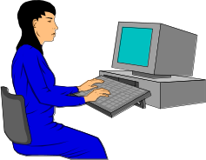

Single Key Encryption
Plain text
message
Encrypt and decrypt with the same key
  How do you get the key safely to the other party?
  What if there are many people involved?
Fast encryption and decryption
  DES (Data Encryption Standard) - old and falls to force attacks
  Triple DES - old but slightly harder to break with force.
  Advanced Encryption Standard (AES)
AES
Key: 9837362
Encrypted
text
Single key: e.g., AES
Encrypted
text
AES
Key: 9837362
Plain text
message

Slide 20


Dual Key Encryption
Message
Message
Encrypted
Alice
Bob
Private Key
13
Public Keys
Alice 29
Bob 17
Private Key
37
Use
Bob’s
Public key
Use
Bob’s
Private key
Alice sends message to Bob that only he can read.

Slide 21
Certificate Authority / Digital Signature
How does Alice know that it is really Bob’s key?
Trust the C.A.
C.A. validate applicants
Public key
  Imposter could sign up for a public key.
  Need trusted organization.
Public Keys
Alice 29
Bob 17
Alice
Use
Bob’s
Public key

Slide 22




Clipper Chip: Key Escrow
Decrypted conversation
Escrow keys
Intercept
Judicial or
government office
Encrypted conversation
Clipper chip
in phones

Slide 23
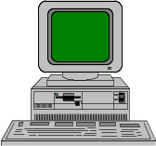

Denial Of Service
Coordinated flood attack.
Target server stalls and does not respond normally
Break in.
Flood program.
Zombie PCs at homes, schools, and businesses. Weak security.

Slide 24
Securing E-Commerce Servers
Install and maintain a working network firewall to protect data accessible via the Internet.
Keep security patches up-to-date.
Encrypt stored data.
Encrypt data sent across networks.
Use and regularly update anti-virus software.
Restrict access to data by business "need to know."
Assign a unique ID to each person with computer access to data.
Don't use vendor-supplied defaults for system passwords and other security parameters.
Track access to data by unique ID.
Regularly test security systems and processes.
Maintain a policy that addresses information security for employees and contractors.
Restrict physical access to cardholder information.

Slide 25



Firewalls
DMZ
Internal company data servers
Keeps local secure data from going to Web servers.
Company PCs
Examines each packet and discards some types of requests.
Access router
Internet

Slide 26




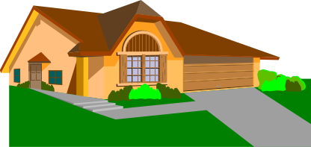
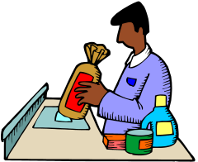



Data Privacy
criminal record
complaints
finger prints
transportation
data
medical
records
financial
permits
census
purchases
Phone
GSM records
grocery store scanner data
credit cards
organizations
subscriptions
education
loans & licenses

Slide 27
Misuse of Cookies: Third Party Ads
Useful Web site
ad Web site
Link to ads
Requested page
Request page
Hidden prior cookie
Useful Web Page
Text and graphics
[Advertisements]
Ads, and cookie
User PC

Slide 28
Wireless Privacy
Cell phones require connections to base stations
Many phones now come with integrated GPS units
Business could market to customers “in the neighborhood”
Tracking of employees is already common

Slide 29
Anonymity
When sending messages over the Internet, many people enjoy a sense of anonymity or at least pseudonymity.
Some IP addresses represent a specific computer. Others, due to proxies and Network Address Translation may represent any number of computers or users. It is usually easy to identify which ISP assigned the address, and this may reveal some identifying information about a person
Should we allow anonymity on the Internet?
  Protects privacy
  Can encourage flow of information
  Can be used for criminal activity

Slide 30
Digital Security Certificates
Digital security certificates are used to encrypt e-mail and to authenticate the sender.
Obtain a certificate from a certificate authority
  Verisign
  Thawte
  Microsoft
  Your own company or agency
Install the certificate in e-mail application
Select option boxes to encrypt or decrypt messages
Install certificates sent by your friends and co-workers.

